Slide 1
Introduction to Java for C++ Programmers
Fundamental Concepts and Classes in Java
Professor: Reza Khojasteh

Slide 2
Class Declaration in Java
The class declaration in Java has the following format:
class SomeName {
// field(s)
// constructor(s)
// method declarations
}
The class contains all the code you have to write. Your code must be enclosed by curly braces.
The objects’ life cycle is determined by the elements of the class as following:
1. Objects’ initializations – Constructors
2. Objects’ states – Fields
3. Class and its objects’ behaviors – Methods
What exactly happens when we say: Student s = new Student();

Slide 3
Creating Objects in Java, Constructors and this, finalize method and garbage collection
Objects vs. references to objects, primitive data type variables vs. reference type variables
Constructors (default, no-argument), and this
Check the examples Student1 to Student4.
Object Equality (ObjectEquality.java)
Pass-by-value (in Java) vs. pass-by-reference (in other languages like C++)
finalize method and garbage collection
Java는 reference value를 사용하므로 Pass-by-value라 하더라도 reference값을 넘기는 것임. 그러므로 이는 C++의 Pass-by-reference와 동일
s = null -> s는 아무것도 가리키고 있지 않음
Notes:
A simple and quick refresher:
What is an object? http://docs.oracle.com/javase/tutorial/java/concepts/object.html
What is a class? http://docs.oracle.com/javase/tutorial/java/concepts/class.html
What is a package? http://docs.oracle.com/javase/tutorial/java/concepts/package.html
Objects in Java are created using an expression containing the new keyword: Point lowerLeft = new Point();
All objects are allocated within an area of system memory known as Heap and are accessed only via an object reference. Each Point object is unique and has its own copy of x and y fields.
The Background Garbage Collector
The Java technology garbage collector achieves high performance by taking advantage of the nature of a user's behavior when interacting with software applications such as the HotJava TM browser. The typical user of the typical interactive application has many natural pauses where they're contemplating the scene in front of them or thinking of what to do next. The Java run-time system takes advantage of these idle periods and runs the garbage collector in a low priority thread when no other threads are competing for CPU cycles. The garbage collector gathers and compacts unused memory, increasing the probability that adequate memory resources are available when needed during periods of heavy interactive use.
This use of a thread to run the garbage collector is just one of many examples of the synergy one obtains from Java technology's integrated multithreading capabilities--an otherwise intractable problem is solved in a simple and elegant fashion.
Copyright © 1997 Sun Microsystems, Inc. All Rights Reserved.

Slide 4
Overview of static (or class variables) in Java
Fields that have the static modifier in their declaration are called static fields or class variables.
They are associated with the class, rather than with any object.
Check the examples Student5 and Student6.
Every instance of the class shares a class variable, which is in one fixed location in memory.
Any object can change the value of a class variable, but class variables can also be manipulated without creating an instance of the class.
Static variable에 대한 메모리는 object와는 별개로 할당됨
Ex) Student.getStacticVariable()
Notes:
constant (final)로 선언하는 변수는 modify 할 수 없으므로, “static final”로 선언하는 것이 좋음
final로 선언하면 어차피 modify 할 수 없으므로, public access modifier사용
즉, public static final variableName;

Slide 5
Some important classes in Java: Math, Arrays, and String (vs. StringBuilder/StringBuffer)
Pass the copy of reference
☞ copy되었더라도 reference값이므로, actual object를 가리킴
Class Math in package java.lang
Arrays are classes in Java; you should create instances (objects) of arrays to work with them.
Default values of arrays in Java, passing arrays to methods, traversing/iterating over 1D arrays, 2D or 3D arrays.
Also, String is a class in Java (SimpleStrings.java). String objects are immutable(변경불가).
Default values of Strings in Java, passing Strings to methods, and checking String’s API.
StringBuilder: a mutable sequence of characters. This class provides an API compatible with StringBuffer, but with no guarantee of synchronization.
Notes:
String클래스가 final로 선언되어 있어 값을 바꿀 수 없음. 무결성은 유지되나, string variable의 수정이 필요한 경우 매번 새로운 String object를 만들어야 하는 불필요한 과정이 생김
(해결책으로 StringBuilder, StringBuffer 사용)
☞ String class : 값을 바꾸지 않을 거면 가장 effective함
☞ StringBuilder : 값을 바꿀 거면 사용. StringBuffer보다 최신 class. Thread 환경에서 thread간 동기화가 보장되지 않음
☞ StringBuffer : 값을 바꿀 거면 사용. Thread환경에서 thread간 동기화가 보장
Arrays
In contrast to C and C++, the Java programming language arrays are first-class language objects. An array in the Java programming language is a real object with a run-time representation. You can declare and allocate arrays of any type, and you can allocate arrays of arrays to obtain multi-dimensional arrays.
You declare an array of, say, Points (a class you've declared elsewhere) with a declaration like this: Point myPoints[]; This code states that myPoints is an uninitialized array of Points. At this time, the only storage allocated for myPoints is a reference handle. At some future time you must allocate the amount of storage you need, as in: myPoints = new Point[10]; to allocate an array of ten references to Points that are initialized to the null reference. Notice that this allocation of an array doesn't actually allocate any objects of the Point class for you; you will have to also allocate the Point objects, something like this:
for (int i = 0; i < 10; i++) myPoints[i] = new Point();
Access to elements of myPoints can be performed via normal C-style indexing, but all array accesses are checked to ensure that their indices are within the range of the array. An exception is generated if the index is outside the bounds of the array.
The length of an array is stored in the length instance variable of the specific array: myPoints.length contains the number of elements in myPoints.
An array is simply a sequence of either objects or primitives, all the same type and accessed together under one identifier name. Arrays are implicit extensions of Object. Arrays are defined and used with square-brackets indexing operator [ ]:
int[] integerArray = new int[3];
A Java array is guaranteed to be initialized and cannot be accessed outside of its range:
for (int k = 0; k < integerArray.length; k++)
integerArray[k] = k;
Creating an array of objects, one is really creating an array of references, and each of those references is automatically initialized to null:
Student[] room = new Student[3];
An array is actually a container object that holds a fixed number of values of a single type. The length of an array is established when the array is created. After creation, its length is fixed.
Strings
Strings are Java programming language objects, not pseudo-arrays of characters as in C. There are actually two kinds of string objects: the String class is for read-only (immutable) objects. The StringBuffer class is for string objects you wish to modify (mutable string objects).
Although strings are Java programming language objects, Java compiler follows the C tradition of providing a syntactic convenience that C programmers have enjoyed with C-style strings, namely, the Java compiler understands that a string of characters enclosed in double quote signs is to be instantiated as a String object. Thus, the declaration:
String hello = "Hello world!";
instantiates an object of the String class behind the scenes and initializes it with a character string containing the Unicode character representation of "Hello world!".
Java technology has extended the meaning of the + operator to indicate string concatenation. Thus you can write statements like:
System.out.println("There are " + num + " characters in the file.");
This code fragment concatenates the string "There are " with the result of converting the numeric value num to a string, and concatenates that with the string " characters in the file.". Then it prints the result of those concatenations on the standard output.
String objects provide a length() accessor method to obtain the number of characters in the string.
Java strings are standard objects with built-in language support. The String class represents character strings. All string literals in Java programs, such as "abc", are implemented as instances of String class. Strings are constant; their values cannot be changed after they are
created. StringBuffer class supports mutable strings. Because String objects are immutable, they can be shared.
String str = "abc";
is equivalent to:
char data[] = {'a', 'b', 'c'};
String str = new String(data);
Copyright © 1997 Sun Microsystems, Inc. All Rights Reserved.

Slide 6
REFERENCES
If a and b are references pointing to objects of the same class, what does the expression (a == b) do?
sets a to point to the same object as b
compares the contents of the reference variables themselves
sets b to point to the same object as a
compares the contents of the objects to which a and b refer
Notes:
Ans. 2
a == b compares references
In next lectures we will see that a.equals(b) compares object contents

Slide 7
A second look at the literals
Study Literals.java to learn more about primitives and literals, as well as enums, static vs. non-static fields and how to access them, final vs. non-final fields, and public vs. package fields.

Slide 8
ARRAY DECLARATION
Let us suppose that you want to declare, create, and initialize an array in Java. Select all the answers that match:
String[] sa[] = {"s1", "s2", "s3"};
String sa[] = ("abc", "def");
String[] sa = {"1", "2", "3"};
String[] sa = {1, 2, 3};
String sa[] = {"a", "b", "c"};
String[] sa = {'a', 'b', 'c'};
Java에서 single quotation(‘ ‘)은 character에서만 사용
Notes:
Ans. 3 and 5
These are the wrong ones:
String[] sa[] = {"s1", "s2", "s3"}; sa is an array of arrays
String sa[] = ("abc", "def"); parenthesis (); it should be {};
String[] sa = {1, 2, 3}; declares String type and initializes integer
String[] sa = {'a', 'b', 'c'}; declares String type and initializes char

Slide 9
CLASS STRING
Class String has a method: String substring(int a, int b). If you called the method with the intention of returning the substring "XWVU" into String Y from String X which has the value "ZYXWVUTS“, which of the following would be appropriate?
Y = X.substring(3,6);
Y = X.substring(3,4);
Y = X.substring(2,6);
Y = X.substring(2,4);
Notes:
Ans. 3
public String substring(int beginIndex, int endIndex):
beginIndex -- the begin index, inclusive.
endIndex -- the end index, exclusive.

Slide 10
An Array Case study
Study the method isOscilant:
public static boolean isOscilant(int[] arr) {
if (arr.length < 2)
return true;
if (arr[0] == arr[1])
return false;
for (int i = 1; i < arr.length - 1; i++)
if (!((arr[i - 1] < arr[i] && arr[i] > arr[i + 1])
|| (arr[i - 1] > arr[i] && arr[i] < arr[i + 1])))
return false;
return true;
}
What is the result of invoking the above method for arrays [1 2 5 8], [2 3 2], [2 3 -2 7 0 1], and [1 2 1 1 8]?
Notes:
Ans. false (Values are all increasing), true (Down and Up), true (Increasing, Decreasing), and false (Flat part 1 1)
An Approach to call the Array Case Study’s method is given in a later slide

Slide 11
Class Arrays, Command-Line Arguments, and Class Scanner
Search Java Class java.util.Arrays in the java api on the Web. It could provide you with a lot of useful operations to be done on the arrays in java.
Command-line arguments (CommandLineArgs.java)
How to input values into your program (Class java.util.Scanner)
Scanner scanner = new Scanner(System.in); int i = scanner.nextInt(); System.out.println(i); scanner.close();
Notes:
Next slide uses Arrays.toString() as an example of one of Arrays class’s methods.

Slide 12
Arrays Case Study
Add“import java.util.Arrays;” to the top line of the java file. Create a class including the method isOscilant (slide 10). At last, create a main method as program entry and add the following code into the main method. Could you guess the output?
System.out.println("Check arrays for oscilant: ");
int array1[] = new int[]{1, 2, 5, 8};
int array2[] = new int[]{2, 3, 2};
int[] array3 = new int[]{2, 3, -2, 7, 0, 1};
int[] array4 = new int[]{1, 2, 1, 1, 8};
System.out.println(Arrays.toString(array1) + " is Oscilant: " + isOscilant(array1));
System.out.println(Arrays.toString(array2) + " is Oscilant: " + isOscilant(array2));
System.out.println(Arrays.toString(array3) + " is Oscilant: " + isOscilant(array3));
System.out.println(Arrays.toString(array4) + " is Oscilant: " + isOscilant(array4));
Notes:
Ans. false (Values are all increasing), true (Down and Up), true (Increasing, Decreasing), and false (Flat part 1 1)

Slide 13
Overview of static (or class variables) in Java (Cont’d)
Any static variables declared in any class are created …
When the first object of the class is created
When the program which uses the class is loaded
Each time the no-parameter constructor for the class is called
When main() method is executed
Notes:
Ans. When the program which uses the class is loaded
A variable which belongs to the class and not to object(instance)
Static variables are initialized only once , at the start of the execution .
These variables will be initialized first, before the initialization of any instance variables
A single copy to be shared by all instances of the class
A static variable can be accessed directly by the class name and doesn’t need any objects.

Slide 14
Relationships between classes (Composition vs. Inheritance), and Nested classes in Java (static vs. non-static/inner, anonymous)
A class definition could contain another class definition besides fields, constructors, and methods (InnerClass.java):
Public class SomeName {
// field(s), constructor(s)
// method declarations
class InnerClass {
// field(s), constructor(s)
// method declarations
}
}

Slide 15
Relationships between Inner and Outer Classes, and Anonymous Class
An inner class is a nested class whose instance exists within an instance of its enclosing class and has direct access to the instance members of its enclosing instance (Automobile.java).
An inner class without a name is called anonymous class. Anonymous classes enable you to make your code more concise. They enable you to declare and instantiate a class at the same time. They are like local classes except that they do not have a name. Use them if you need to use a local class only once (to be more discussed in future lectures.)

Slide 16
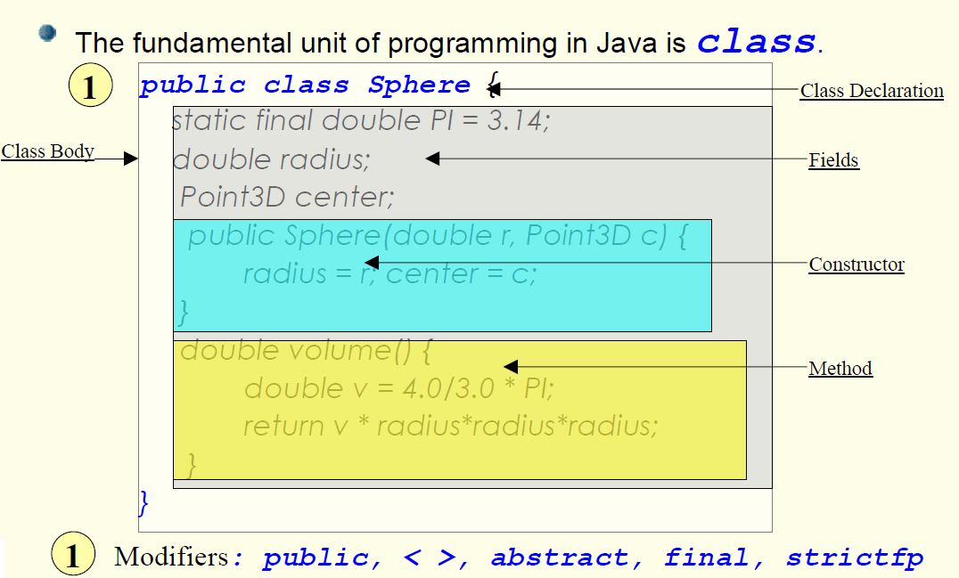
Further Study: Class Structure

Slide 17
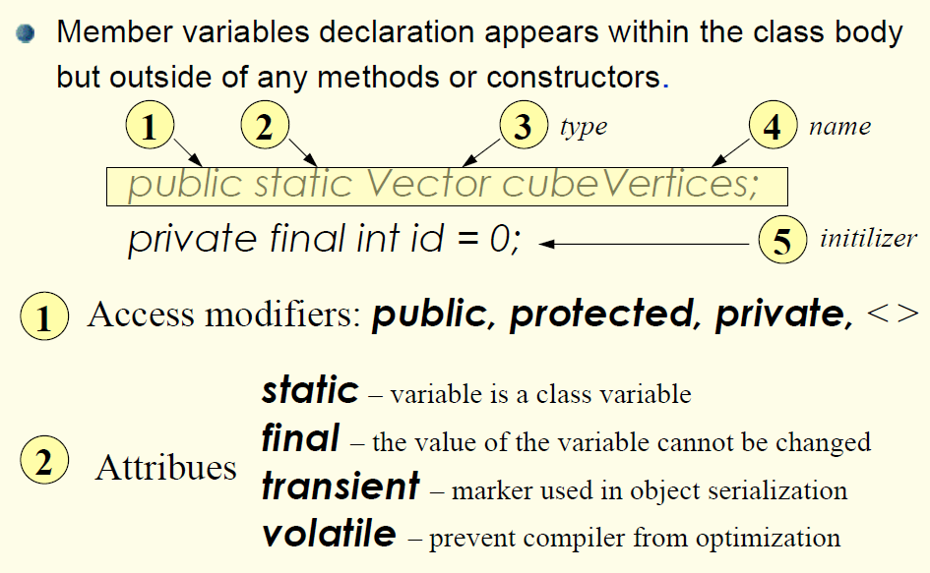
Further Study: Instance/Member Variables (Fields)

Slide 18
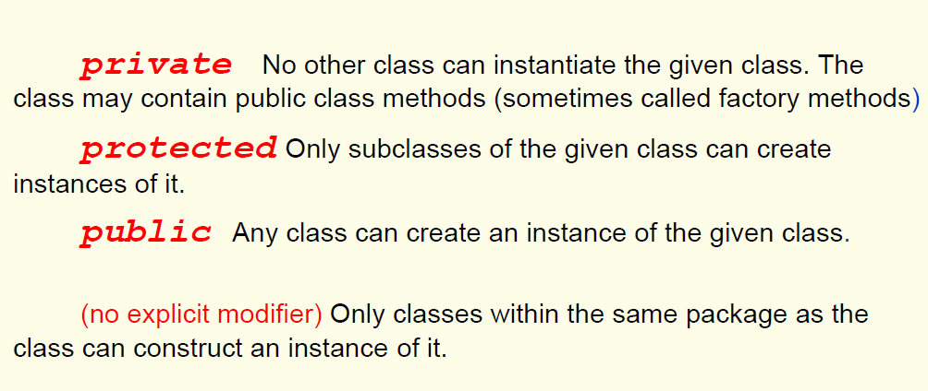
Further Study: Access Modifiers for Constructors

Slide 19
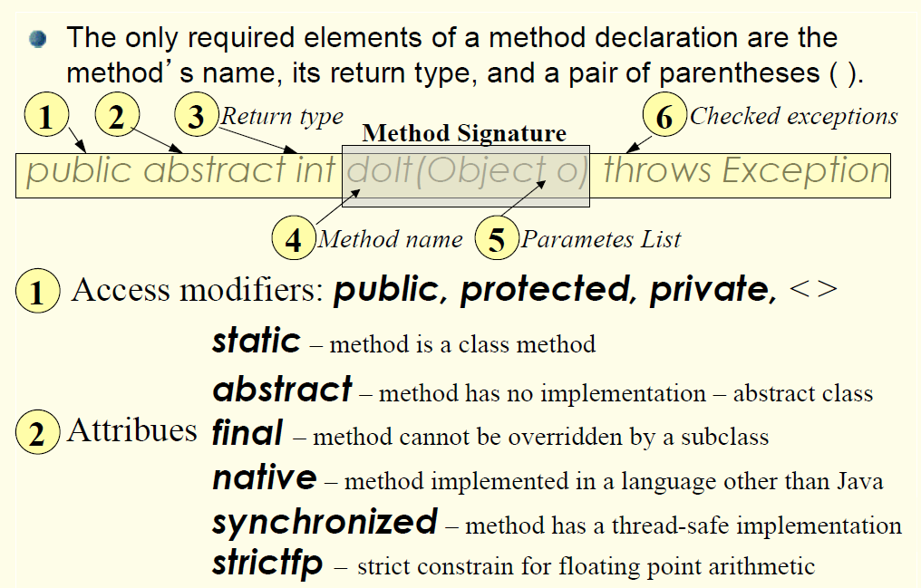
Further Study: Method Declaration

Slide 20
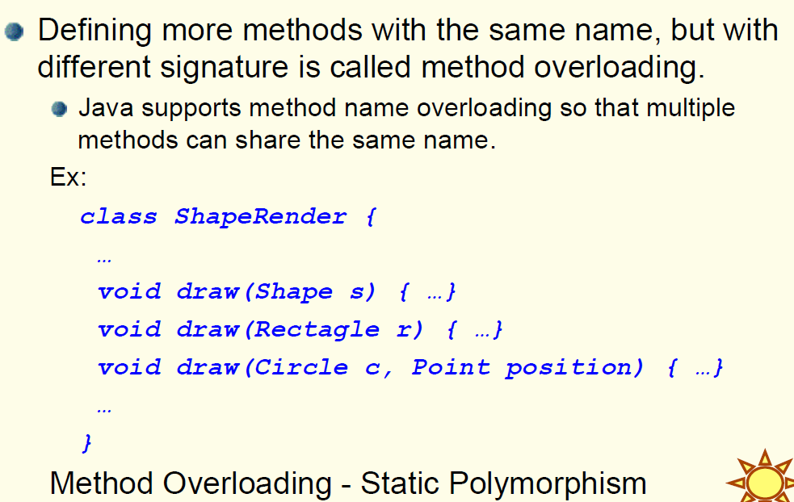
Further Study: Method Overloading

Slide 21
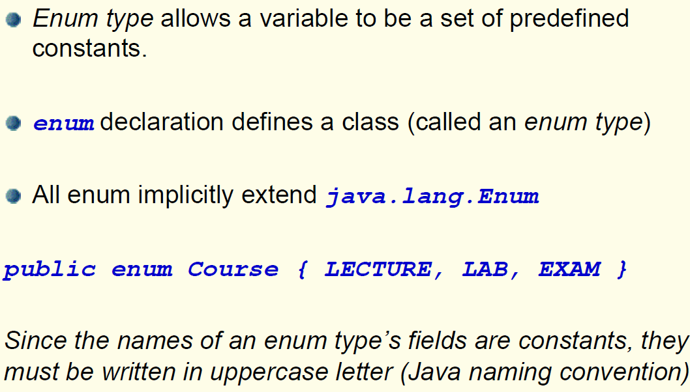
Further Study: Enum Types

Slide 22
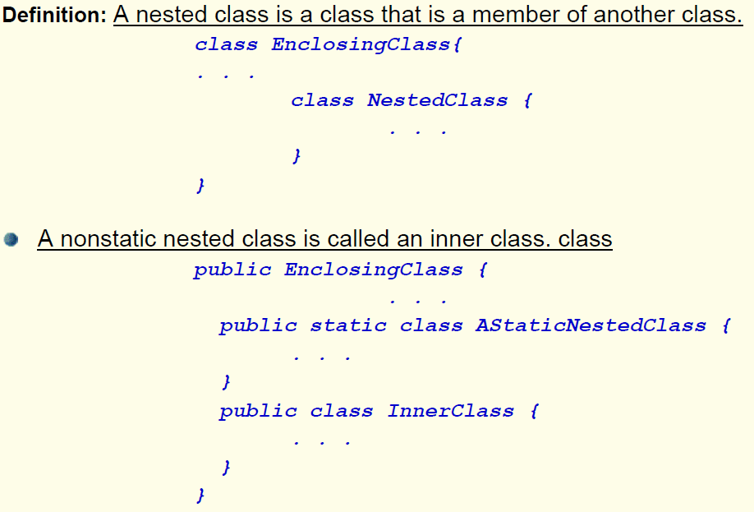
Further Study: Nested Classes

Slide 23
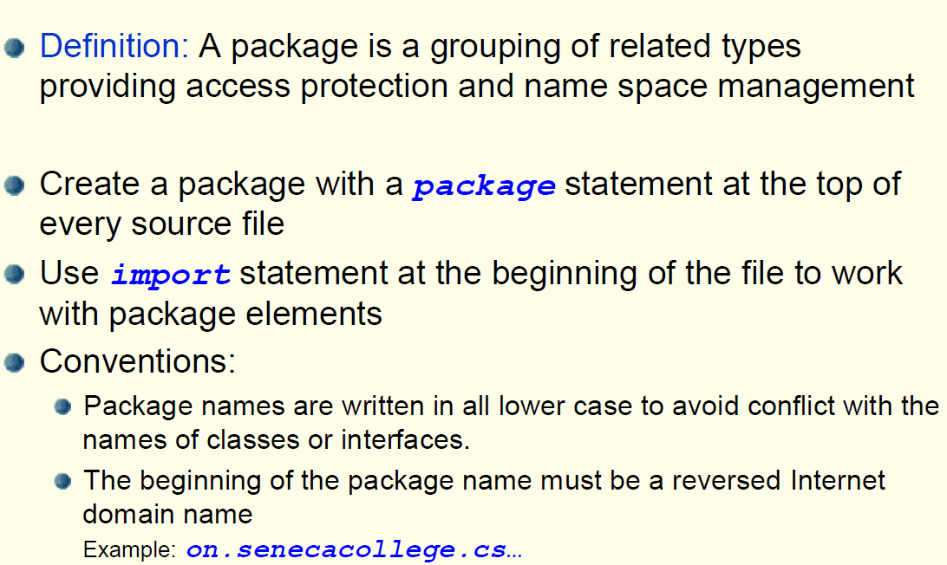
Further Study: Packages

Slide 24
PACKAGE
If a class is NOT a member of a named package, select the answers that match:
It will belong to the default package.
It makes all its data visible to every other class.
It makes all its non-private data visible to all members of the default package.
It will cause a warning at compile time.
Notes:
Ans. 1 and 3

